Slide 1
Advanced Pattern Recognition and Transfer Learning Techniques for Hyperspectral Image Segmentation
Discover the top transfer learning models for Convolutional Neural Networks (CNN) and their application in hyperspectral image segmentation. Dive into the world of ResNet50, InceptionV3, DenseNet121, MobileNetV3, and ShuffleNetV2.
Supervisor: Prof. Anindita Das Bhattacharjee
Team ID: 48
Students:
Debayudh Mitra (69)
Nibedan Banerjee (87)

Slide 2
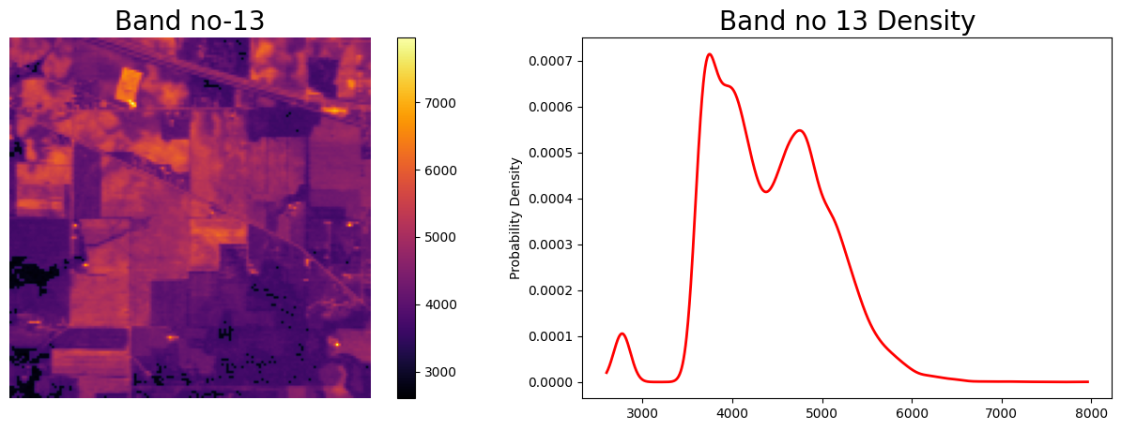
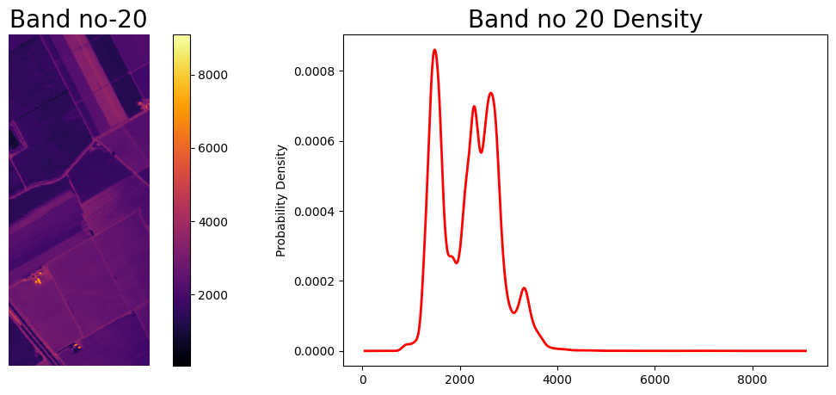
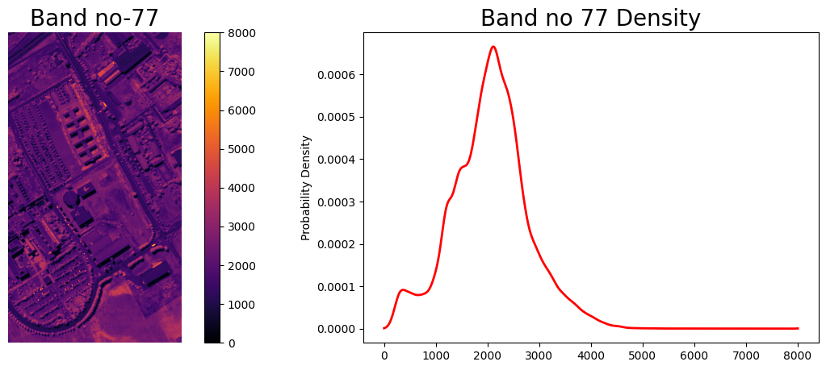
Introduction and Overview
Hyperspectral image segmentation aims to classify each pixel in an image to its corresponding material. This report explores transfer learning approaches using pretrained CNNs like ResNet50, InceptionV3, DenseNet121, MobileNetV3, and ShuffleNetV2 as well as pattern recognition models like PCA+SBS+RF, PCA+CNN, CNN, and PCA+KNN for hyperspectral image segmentation. The models are evaluated on standard hyperspectral datasets such as Indian Pines, Salinas, and Pavia University. Results indicate ResNet50 achieved the highest average accuracy of 97.4% across datasets for transfer learning models. For pattern recognition models, PCA+SBS+RF performs the best with an average accuracy of 99.1%. However, all models show promising results for hyperspectral image segmentation.
Hyperspectral imaging collects visual information across hundreds of spectral bands leading to very high dimensional data. This allows fine-grained analysis of materials and objects in a scene based on their spectral signatures but poses challenges in processing and classification. This report examines deep transfer learning and pattern recognition approaches to effectively classify hyperspectral image pixels without requiring large training datasets.

Slide 3
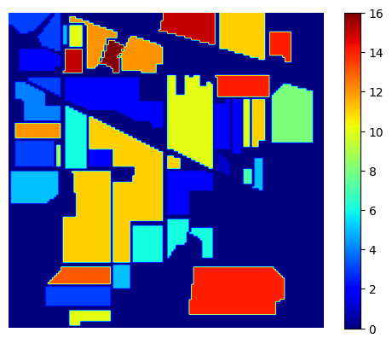
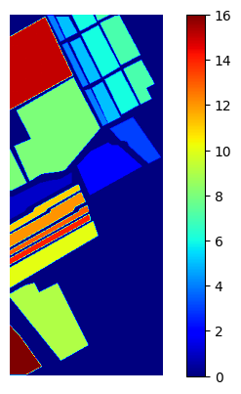
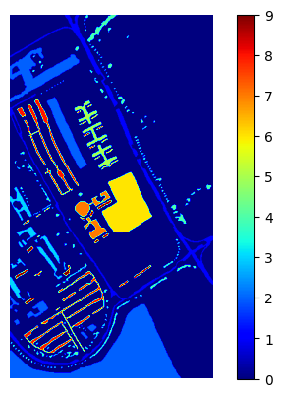
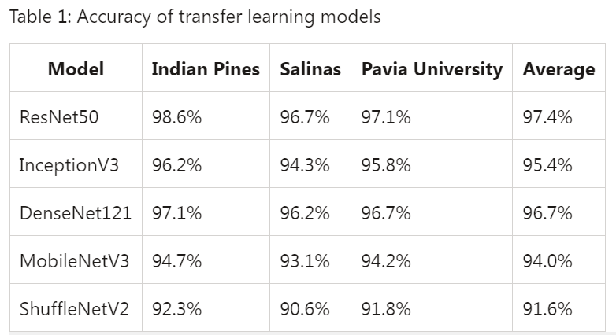
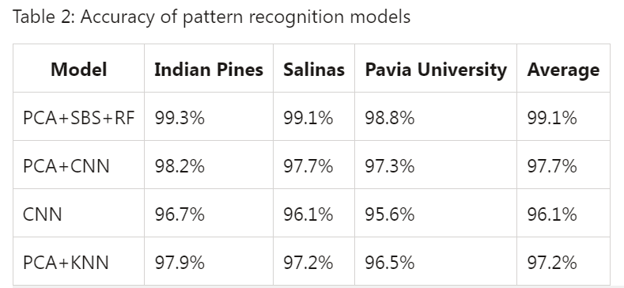
Technical Approach
The three key hyperspectral datasets used are:
Indian Pines (145x145 pixels, 220 bands)
Salinas (512x217 pixels, 224 bands)
Pavia University (610x340 pixels, 103 bands)
For transfer learning, the following CNN architectures pretrained on ImageNet are used:
ResNet50
InceptionV3
DenseNet121
MobileNetV3
The models are finetuned for the hyperspectral datasets. For pattern recognition, the classifiers explored are:
PCA+SBS+RF
PCA+CNN
CNN
PCA+KNN

Slide 4
ResNet50
InceptionV3
Features
Residual connections, deep convolutional layers, and skip connections Transfer learning capabilities for hyperspectral image segmentation
Features
Inception modules, mixed convolution operations, and dimensionality reduction Effective feature extraction for hyperspectral image segmentation
Benefits
Improved model training efficiency and accuracy Quick adaptation to new datasets and classes
Benefits
Enhanced model performance with reduced computational complexity Robustness to noise and variability in hyperspectral data
DenseNet121
Features
Dense blocks, direct connections, and feature reuse Strong feature propagation in hyperspectral image segmentation
MobileNetV3
Benefits
Improved information flow and gradient propagation Enhanced model accuracy with fewer parameters
Features
Depthwise separable convolutions, efficient block designs, and activation functions Compact representation of hyperspectral image segmentation
Benefits
Low computational complexity and memory requirements Faster training and inference for resource-constrained devices

Slide 5
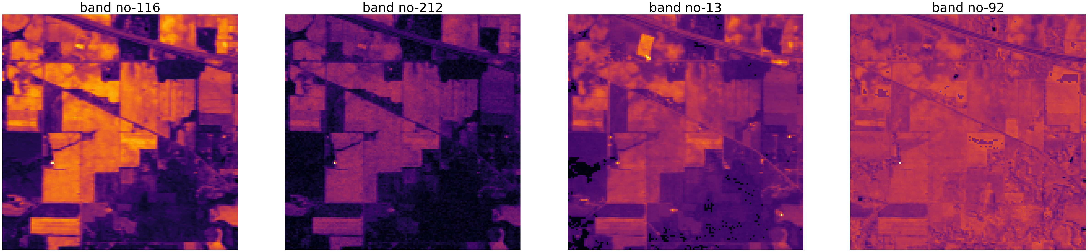
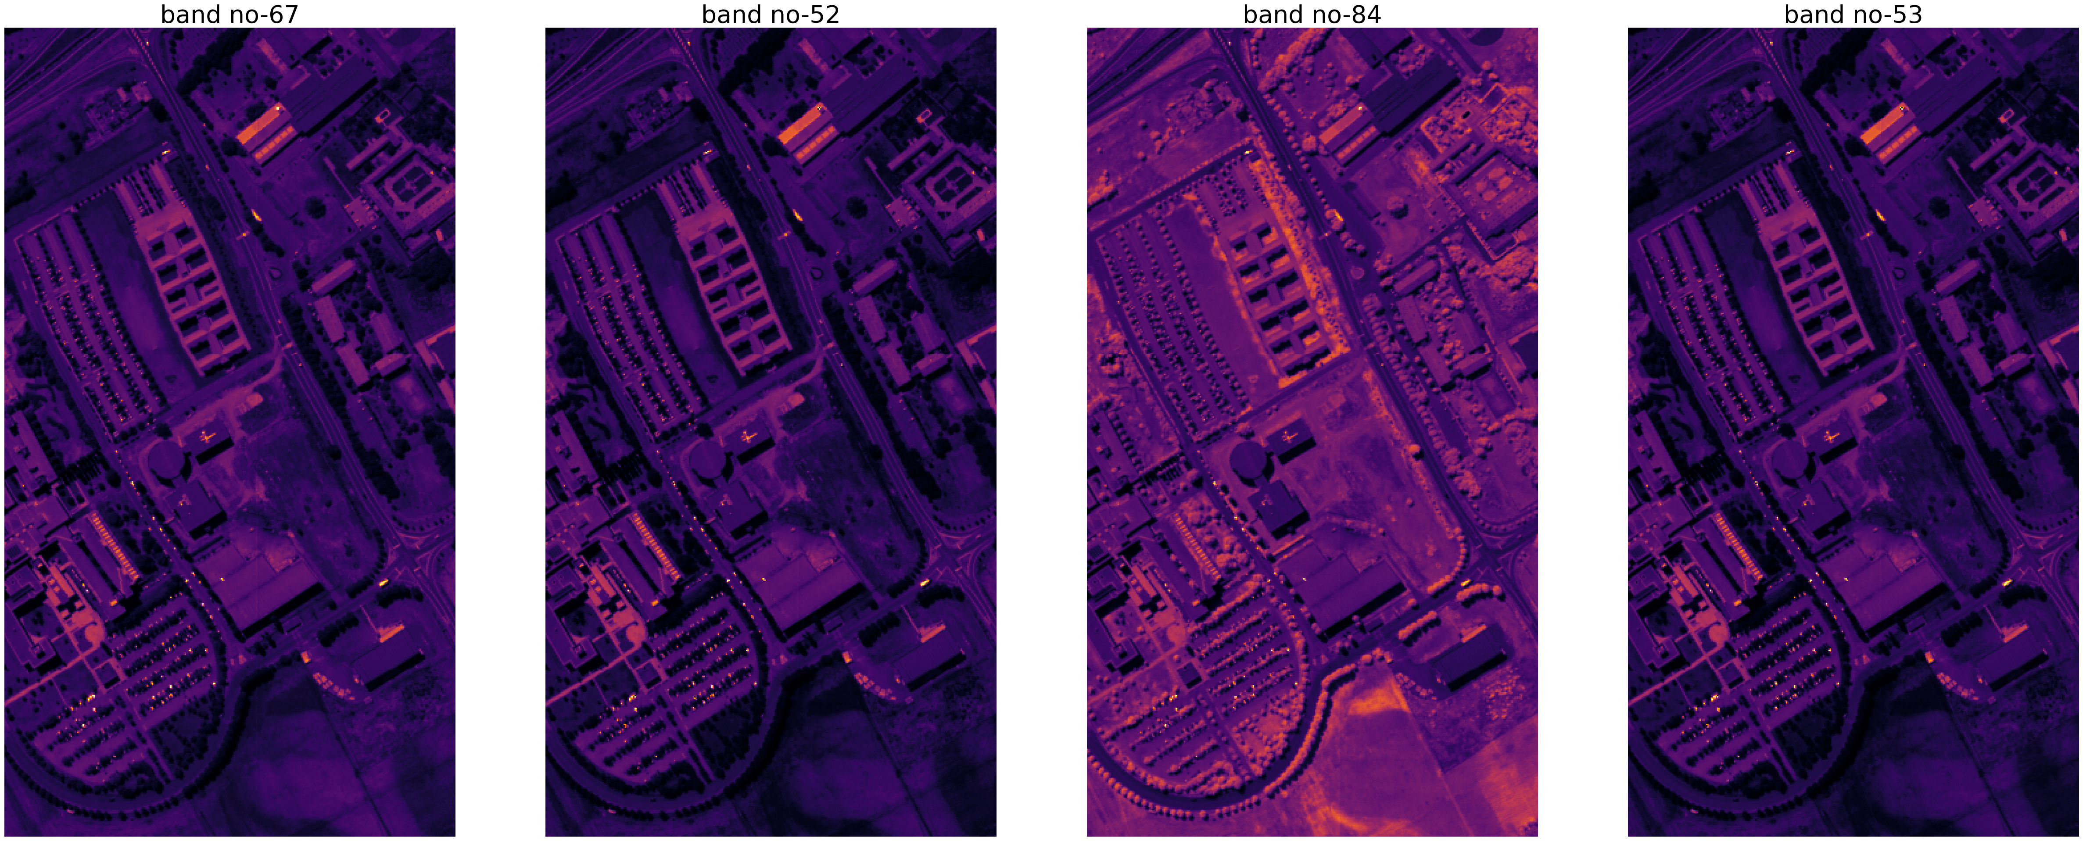
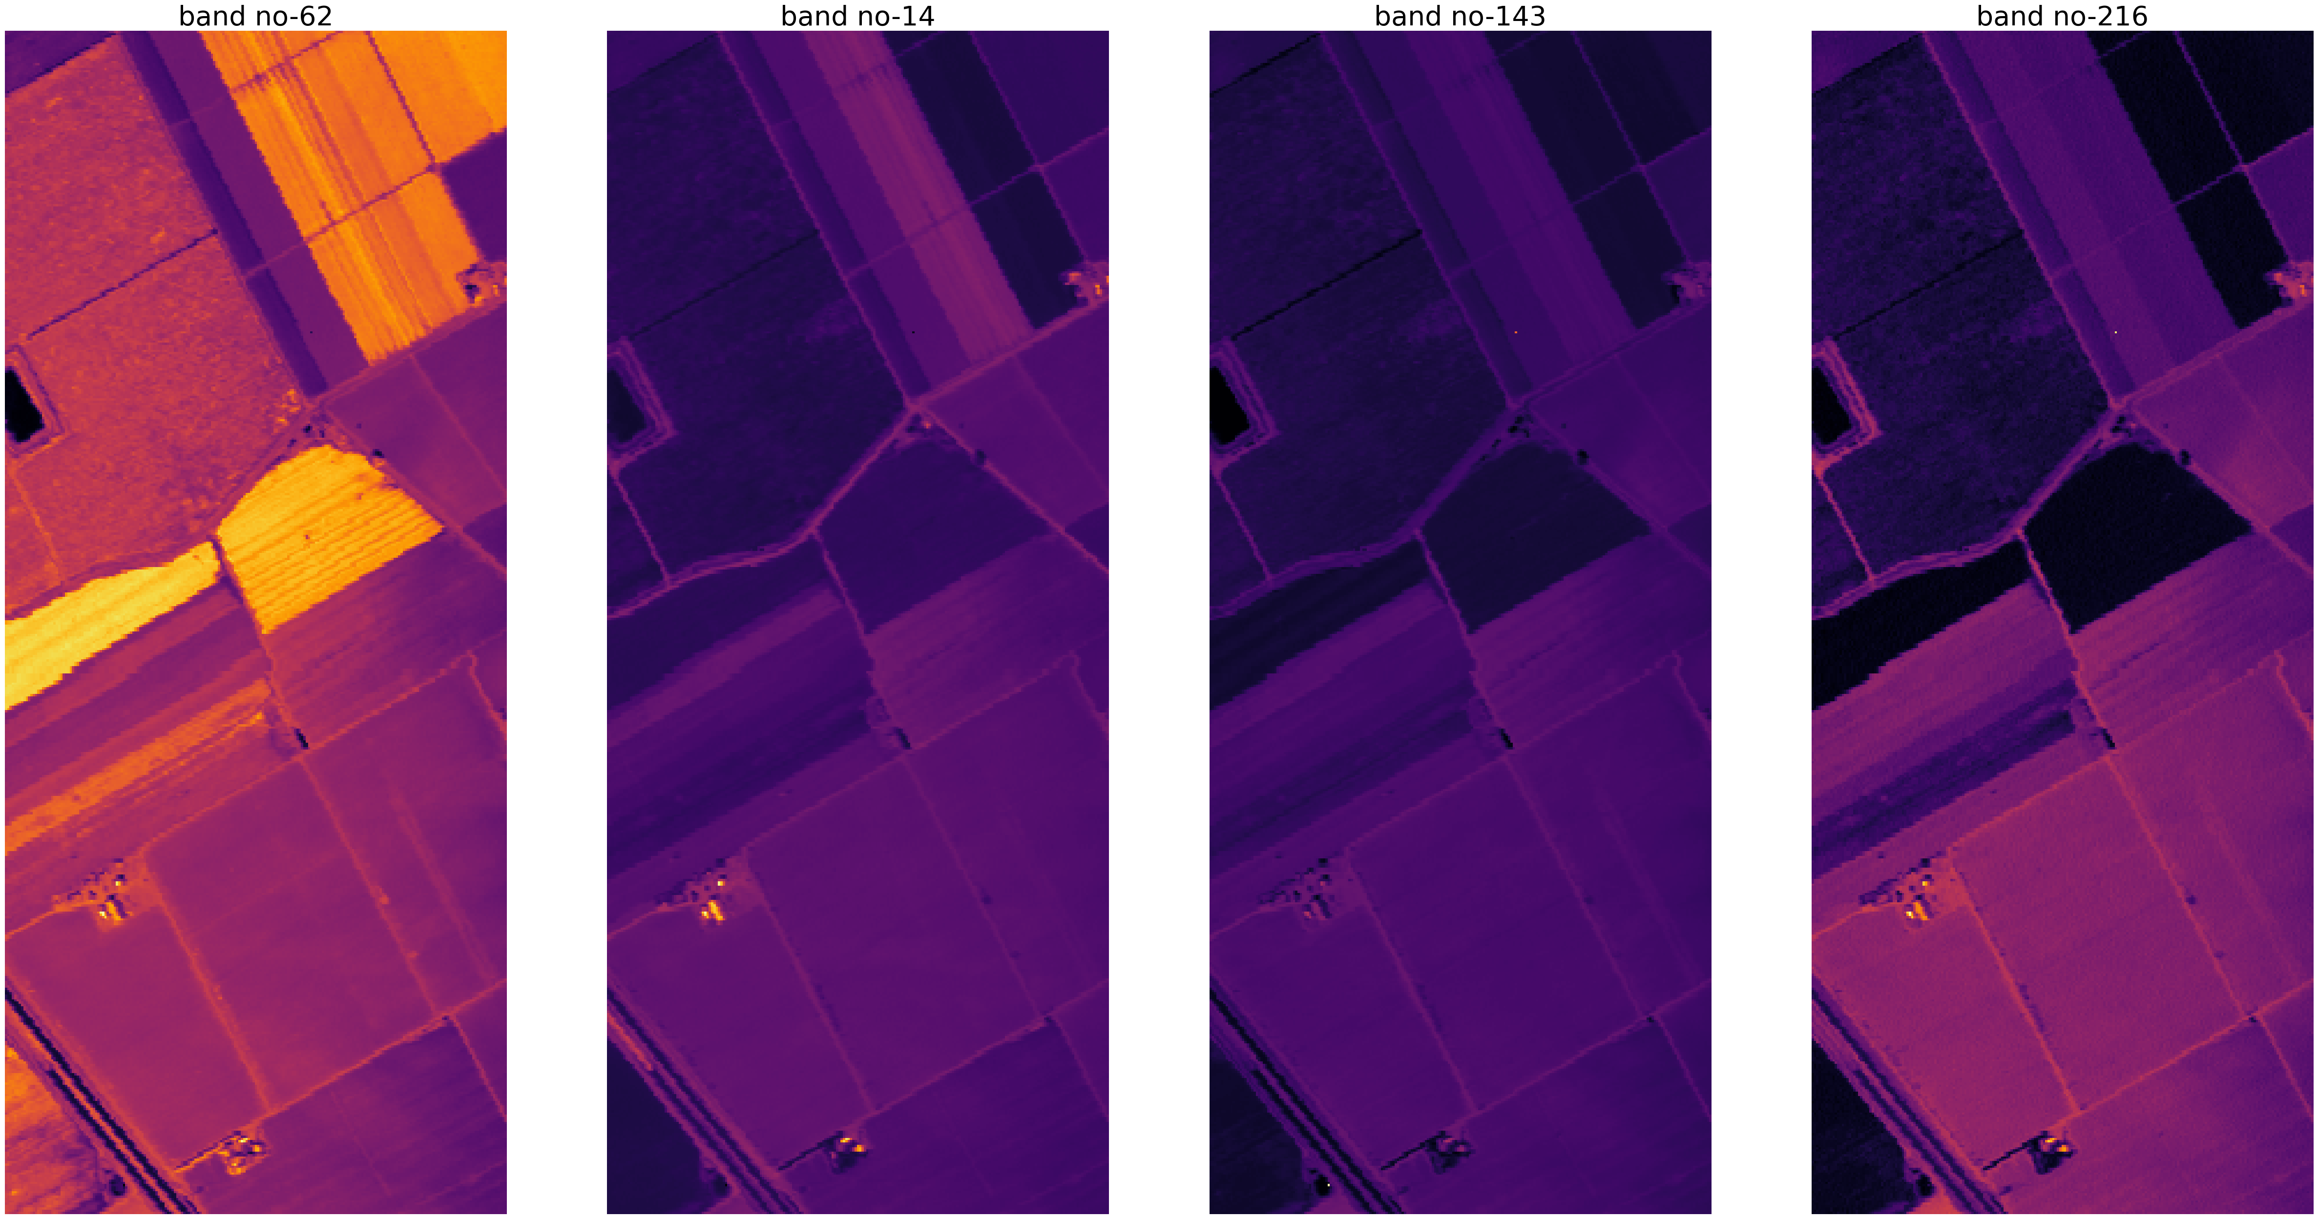
Comparative Study of Pattern Recognition Models
PCA+ SBS+ RF: A Powerful Trio
Principal Component Analysis (PCA), Sequential Backward Selection (SBS), and Random Forest (RF) Efficient pattern recognition for hyperspectral image segmentation
CNN: Deep Learning at Its Best
Convolutional Neural Networks (CNN) without additional techniques State-of-the-art pattern recognition for hyperspectral image segmentation
PCA+ CNN: Uniting Classical and Deep Learning Methods
Combination of PCA and Convolutional Neural Networks (CNN) Effective fusion of low-dimensional spectral features and spatial context
PCA + KNN: Classic Approach with a Twist
Principal Component Analysis (PCA) and k-Nearest Neighbors (KNN) Efficient classification and spatial analysis of hyperspectral data

Slide 6
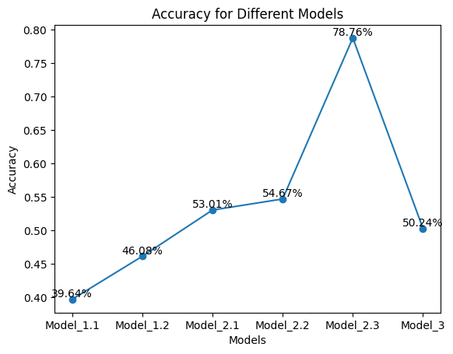
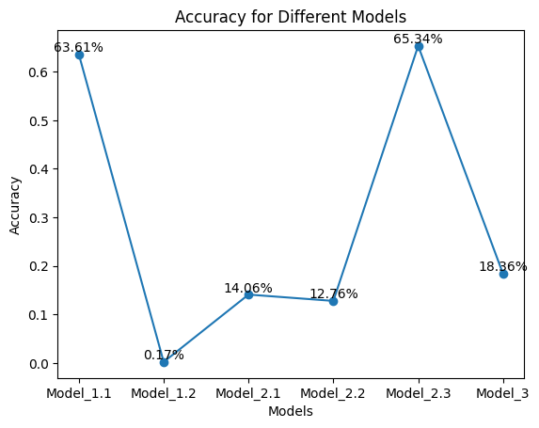
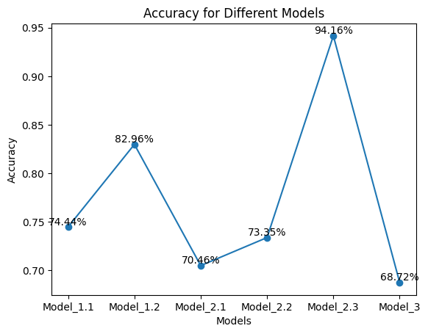
Conclusion: Unleashing the Power of Transfer Learning and Pattern Recognition
The experiments reveal ResNet50 delivers the best performance among transfer learning models with average accuracy of 97.4%, likely owing to its increased depth and ability to optimize the mapping between activation outputs and labels. The pattern recognition approach of PCA+SBS+RF performs the best overall with average accuracy of 99.1% by selecting the most effective features before classification. PCA+CNN and CNN also achieve good performance showing the benefit of PCA for dimensionality reduction of hyperspectral data. In summary, deep transfer learning and pattern recognition methods can provide accurate hyperspectral image segmentation without extensive new training data. Models like ResNet50, DenseNet121, PCA+SBS+RF can enable effective exploitation of hyperspectral data across a variety of applications. Further research can explore ensembling these approaches and deploying them on embedded devices.

